Slide 1

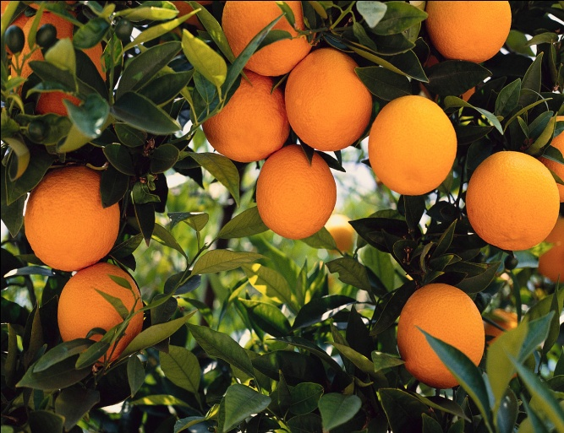
Competition Law and Policy
A Presentation to LEA Horticulture Subsector Stakeholder Meeting on Competition Issues
22nd January 2014
Mr. Ernest Bagopi

Slide 2

INDEX
PART ONE
Overview about Competition Authority
PART TWO
Competition Law and Policy

Slide 3
PART ONE
OVERVIEW
(COMPETITION AUTHORITY)

Slide 4
INTRODUCTION
Competition Authority commissioned on 18 April 2011
It was created by an Act of Parliament, namely, the Competition Act of 2009. The Competition Act is a derivative of the Competition Policy of 2005
Rules and Regulations (for the Act) became effective on 14th October 2011
Similar to other Competition bodies around the globe, the Competition Authority (Botswana) is a statutory body set up to ensure fair trading in the Botswana market

Slide 5
INTRODUCTION
The mandate: - responsible for the prevention and redress of anti-competitive practices in the economy, and the removal of constraints on the free play of competition in the market (VISION STATEMENT: To secure prosperity through fair markets)
An Independent body: - financed by Government but maintains autonomy in its operations
It is therefore termed a parastatal or quasi-government entity

Slide 6
RATIONALE
The economic mapping commissioned by Government identified the following:
  There was market dominance e.g. in the meat industry, sugar industry, beverages, mining and the motor vehicle distribution sectors. Firms in these sectors were found to enjoy substantial market power. As a consequence tendering for public procurement may be open to collusion amongst bidders.

Slide 7
RATIONALE (CONT’D)
  There were also instances of creation of cartels (horizontal agreements), market allocation, bid rigging, price fixing, predatory pricing, and possible abuse of dominance in monopolistic environments. These anti-competitive practices crucially required the establishment of the Competition Authority to address.
  There was a rapid increase of chain stores and supermarkets, franchising as well as the proliferation of distance selling which tended to exclude local firms.

Slide 8
RATIONALE (CONT’D)
  There was also recognition that there existed legislation and regulations that hindered competition in the market (particularly entry into the market). The idea was to bring all pieces of legislation that affect competition under one Act, viz the Competition Act, to be implemented and enforced by the Competition Authority.

Slide 9
RATIONALE (CONT’D)
The regional and global benchmarking showed that many other countries had set-up such entities to improve their market competitiveness.
Botswana National Vision (Vision 2016) emphasises the need to promote competitive markets; with the high level objective to transform the country into a competitive, winning and prosperous nation.

Slide 10
GOVERNANCE ISSUES
It is important to note that the Competition Authority is governed by the Competition Commission that acts as the Board of Directors and the Adjudication body on matters of anti-competitive trade and restrictive business practices
Commission in place since 2010
Membership (of 7 Commissioners) is from:
  Private sector
  University
  Ministry of Trade and Industry

Slide 11
GOVERNANCE ISSUES
CEO (Executive Secretary) assumed office on 18th April 2010 – hence operation of the Authority commenced on the same date
Mr. Thula Kaira – extensive experience in Competition Law and former CEO of Zambia Competition Commission (ZCC)
5 departments

Slide 12
PART TWO
COMPETITION LAW AND POLICY

Slide 13
BENEFITS OF COMPETITION
Wider choice of goods and services – to consumers
Reasonable prices
More innovation
Higher quality products and services
Effective Competition Law is a means of inspiring International confidence in an economy

Slide 14
COMPETITION LAW AND POLICY
This is a law that promotes or maintains market competition by regulating anticompetitive conduct/behaviour of companies.
Competition Law focuses on anticompetitive practices such as:
Horizontal agreement (Section 25)
Vertical agreement (Section 26)
Abuse of dominant market position (Section 30)
Mergers and acquisitions (Part X)

Slide 15
Horizontal agreement
It is an agreement between enterprises each of which operates, for the purpose of the agreement, in the same market and would therefore normally be actual or potential competitor in that market.
i.e. between producers or between wholesalers or between retailers dealing in similar kinds of products.

Slide 16
Diagrammatic presentation on Horizontal agreement
Producer A(tomatoes)
Producer B(tomatoes)
Producer C(tomatoes)

Slide 17
Common horizontal agreements
Price fixing (Section 25(a))
Directly or indirectly fixing a purchase or selling price or other terms of sale.
e.g. An agreement between Retailer X and Retailer Y to sell tomatoes at P35 /packet or with similar terms of sale.

Slide 18
Bid Rigging (Section 25(c))
Parties agree upon the price terms and conditions of a bid to be submitted; or one of the parties to the agreement agrees not to submit a bid.
e.g. An agreement between Farmer A and Farmer B to quote same price terms and conditions when bidding or either one of the parties agrees not to bid.

Slide 19
Territorial Restraint (Section 25(b))
Dividing markets by allocating customers, suppliers, territories or specific type of goods and services.
e.g. An agreement between farmer A selling chickens for the northern part and farmer B in selling chickens in Southern part of the country only .

Slide 20
2.Vertical agreement
Agreement between enterprises each of which operates, for the purpose of the agreement, at a different level of the production chain and relates to the conditions under which the parties may purchase, sell or re-sell certain goods or services.
i.e. Vertical agreements are those between enterprises at different stages of the manufacturing and distribution process, for example, between manufacturers of components and manufacturers of products incorporating those goods, between producers and wholesalers, or between producers, wholesalers and retailers.

Slide 21
Diagrammatic presentation on Vertical agreement
Producer
Wholesaler
Retailer
Consumer

Slide 22
Common Vertical Agreements
Tied selling (Section 27(2)(c)
A Supplier requires a customer to buy one product as a condition of acquiring another.
e.g. A supplier of seedling requires a farmer to buy fertilizer in order to get the seedlings.

Slide 23
Continued..................
Exclusive supply or distribution
This is where a supplier chooses to deal with one distributor in a location. (Competition risk is foreclosure of other distributors)
e.g. Supplier A of fertilizers chooses to deal with only distributor B who is in Palapye.
Resale price maintenance (Section 26(1))
A Supplier of products dictates a fixed resale price.
e.g. Farmer X dictates to retailer Y fixed retail price

Slide 24
Continued………………….
Refusal to deal or Supply
Concerted refusals to purchase or to supply, or the threat thereof. Group boycotts may be horizontal (i.e. cartel members may agree among themselves not to sell to or buy from certain customers), or vertical (involving agreements between parties at different levels of the production and distribution stages refusing to deal with a third party, normally a competitor to one of the above).

Slide 25
3. Dominant Market Position
(Section 31)
    A situation in which one or more enterprises pose such economic strength in a market so as to allow the enterprises to adjust prices or output without effective constraint from competitors or potential competitors.

Slide 26
Threshold to determine dominance
Competition Regulations 4(a)(b) stipulates that the Authority may consider an enterprise to be in dominant position if it is satisfied that a
(a)the enterprise acquires at least 25 % of the goods or services in the market ; or
(b) three or fewer enterprises supply or acquire at least 50 % of the goods and services in the market.

Slide 27

Diagrammatic presentation on determination of dominance

Slide 28
Common practices under Abuse of Dominant Market Position
Predatory pricing (Section 30)
Low pricing of goods and services to induce existing firms to exit the market or high pricing of goods and services to block entrants into the market.
e.g. A dominant farmer of tomatoes prices his tomatoes too low as compared to the market price so as to make it unprofitable for other farmers and induces them to close down; or either pricing the tomatoes higher such that new famers cannot enter the market as they will perceive the business not viable.

Slide 29
Continued……….
Price discrimination
It occurs where a product is sold to different consumers at different prices that do not reflect differences in the cost of supply.
e.g. Farmer X sells tomatoes to Maun Spar at P5/packet and sells it to Maun Choppies at P8/packet.

Slide 30
Continued……………………………………
Tied selling
Dominant firms can leverage market power in one market into a related market by tying products together which leads to reduction in competition in the related market.
E.g. A dominant firm of seedling requires farmers to buy fertilizer in order to get the seedlings.

Slide 31
Continued…….
Refusal to supply
The practice of refusing or denying supply of a product to a purchaser, usually a retailer or wholesaler. It prevents third party firms entering the market and this has the effect of lessening competition.
e.g. The Horticultural market refuses to stock farmer X’s Oranges but the reasons advanced are not based on whether the business has bad credit risk or not; hence not a reason to protect business interest.

Slide 32
4.Mergers and acquisitions
Mergers occurs when one or more enterprises directly or indirectly acquire or establishes direct or indirect control over the whole or part of the business of another enterprise. (Section 52(1))
Ways
Purchase or lease of shares, an interest, or assets of the other business in question; or
Amalgamation or other combination with that enterprise.

Slide 33
Assessment of mergers and acquisitions
The assessment of mergers or takeovers by the Commission focuses on the question of whether a proposed transaction is likely to prevent, distort or lessen competition in a relevant market.
Mergers that are in unusually concentrated markets, or that create firms with unusually high market shares, are thought more likely to affect competition.

Slide 34
Remedial measures
The commission may impose a financial penalty not exceeding 10 % of the turnover of the enterprise during the breach of prohibition which is either under Horizontal and vertical agreement up to a maximum of three years.

Slide 35
CHALLENGES
Selling the role of the Competition Authority in the right context
  The need to make it known that the Competition Authority is not an organ established to frustrate business. Rather its objective is to facilitate competition in the market and ensure that both consumers and businesses interact for the benefit of each other.
Lack of information – when dealing with matters of anti-competition.

Slide 36
Reporting anti-competitive practices to Competition Authority
Coming in person to Competition Authority office
Writing a letter
Use of e-mail
Use of fax or telephone

Slide 37
THANK YOU
Contact Details:
Competition Authority
Plot 28,Matsitama Road
Private Bag 00101
Gaborone
Tel:(+267)393 4278 Fax(+267)3121013
competitionauthority@gmail.com

